Slide 1
VIPASSANĀ MANAGEMENT SYSTEM
Daniela Koch
Matej Michalek
Michaela Golhova
Michal Karol Pompa
Remedios Pastor Molines

Slide 2
Agenda
Introduction
Analysis
Design
Implementation
Process
Conclusion

Slide 3



Introduction
US
VIA

Slide 4


Slide 5

Problem statement
How to store data about events, members and lecturers?

Slide 6

Problem statement
How to find proper lecturers for events ?

Slide 7

Problem statement
How to make the system easy to extend and provide new functionalities?

Slide 8






Delimitations
FEEDBACK

Slide 9


Slide 10




Functional requirements
Members/Participants
Lecturer
Event
Newsletter

Slide 11
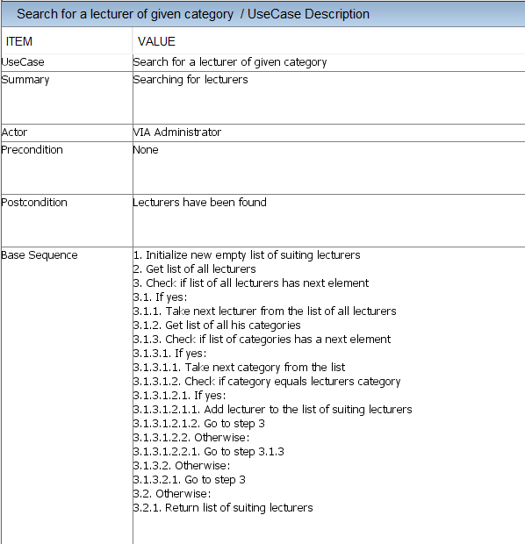

Slide 12
Functional requirements
Members/Participants
Lecturer
Event
Newsletter

Slide 13



Non-functional requirements
The system must be implemented in Java
Secondary storage needs to be done with files (Event/Lecturer/Memberlists, newsletter)
The parts of the system must be accessible among them

Slide 14
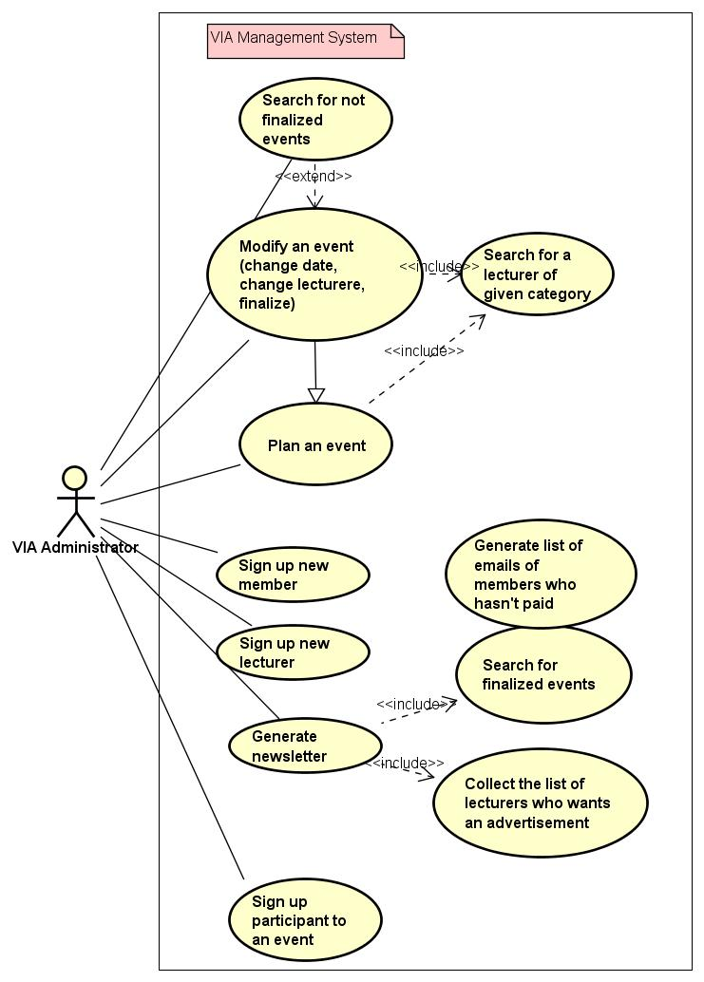
USE CASE DIAGRAM

Slide 15
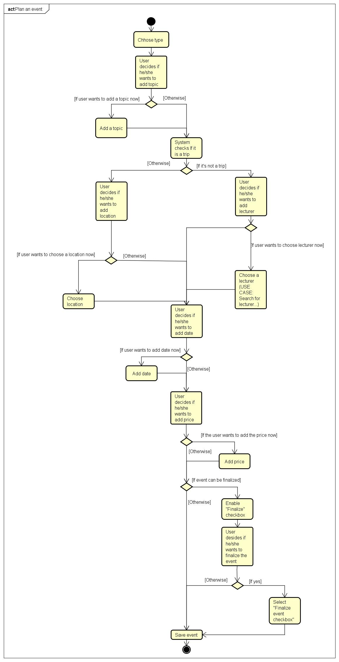
ACTIVITY DIAGRAM Create event

Slide 17
Design

Slide 18
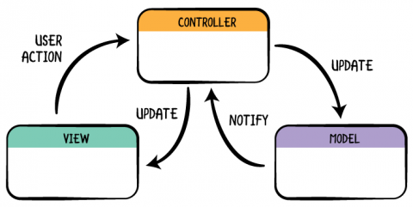
Model-view-controller

Slide 19
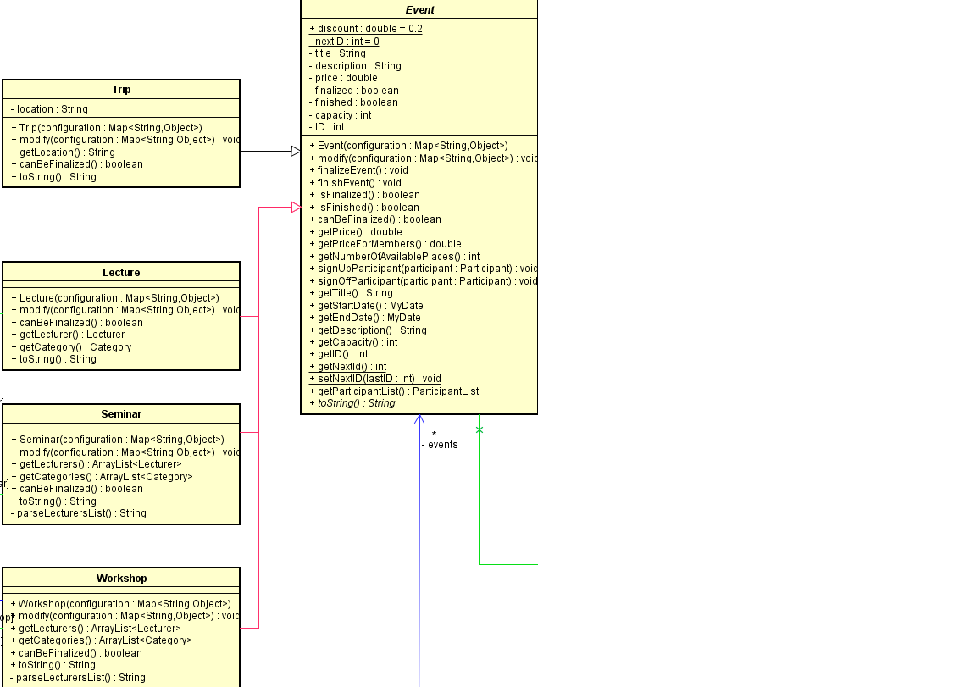
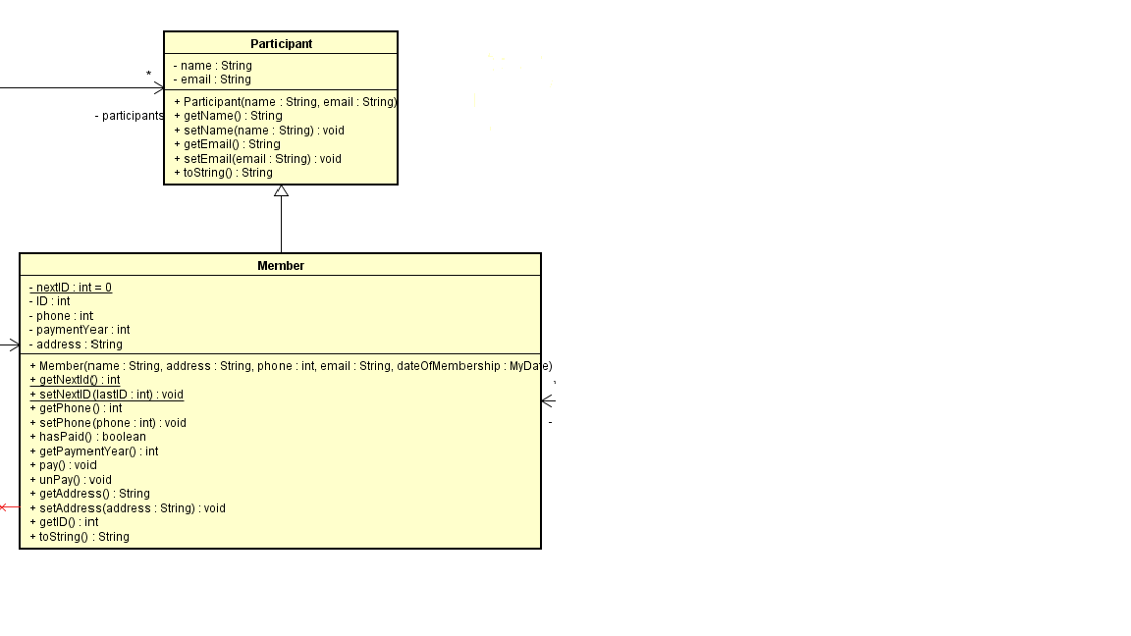
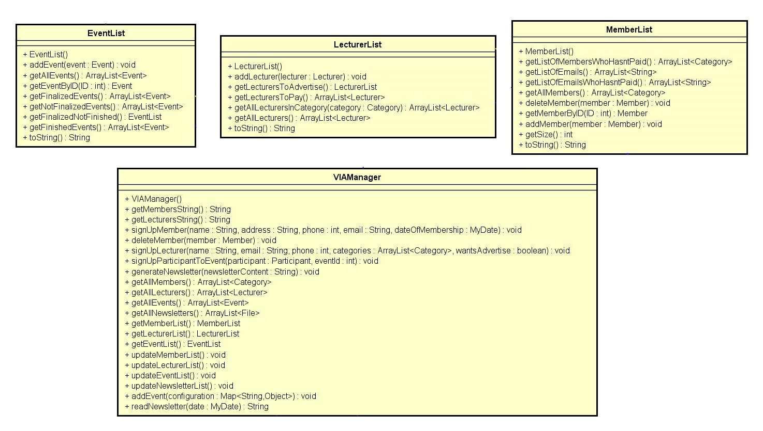
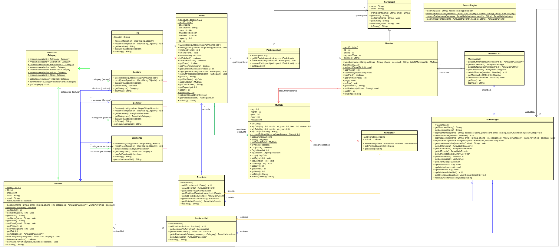
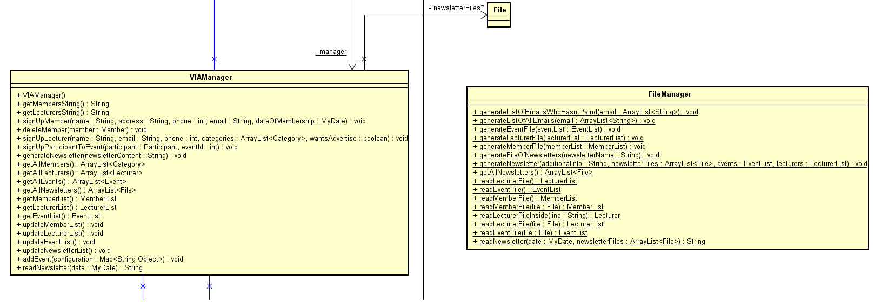
Model

Slide 20
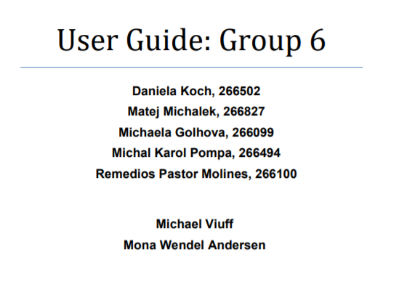
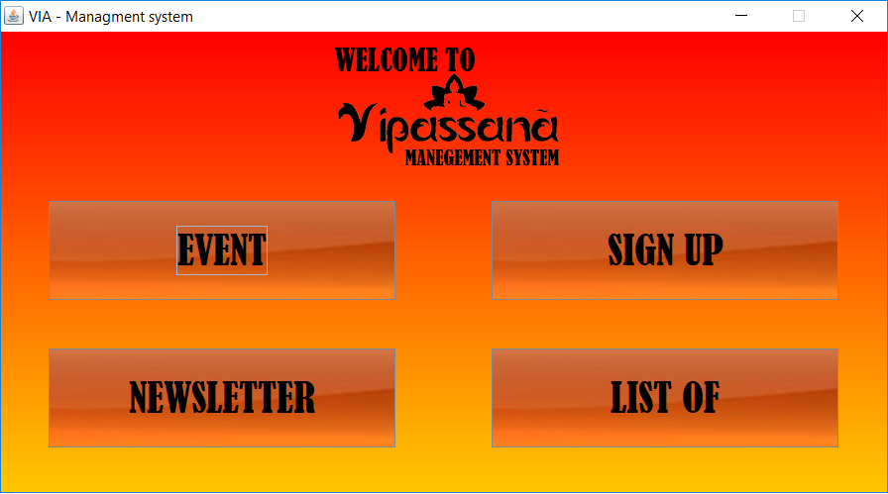
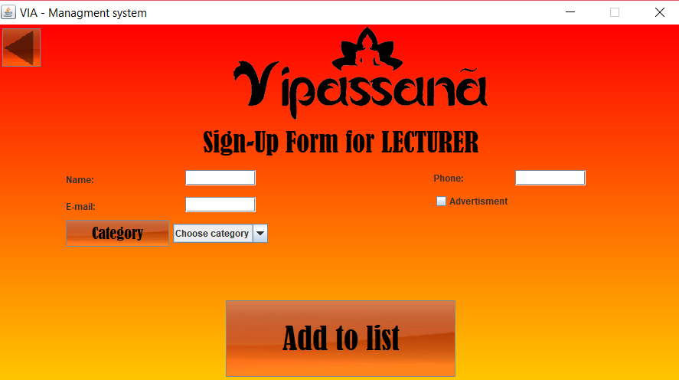
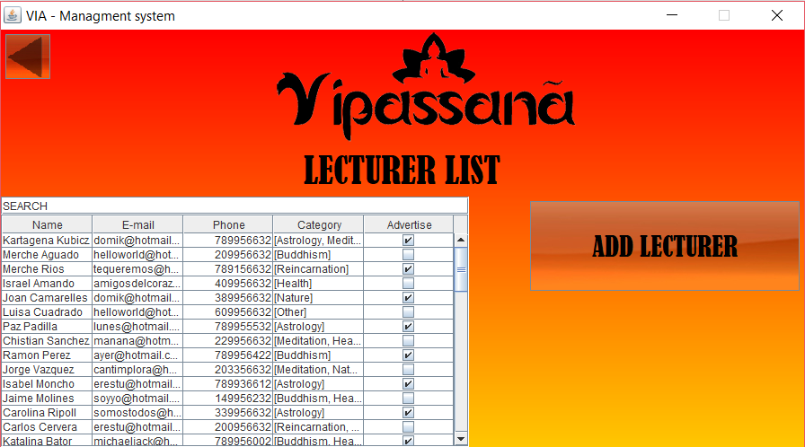
View

Slide 21
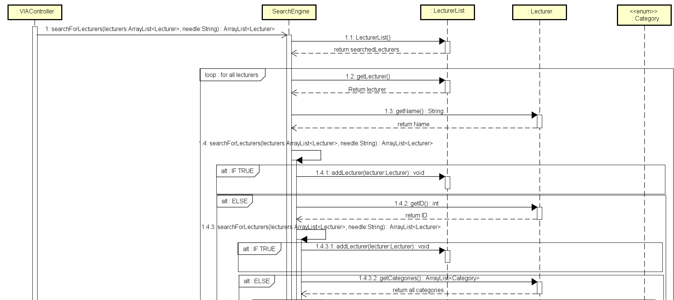
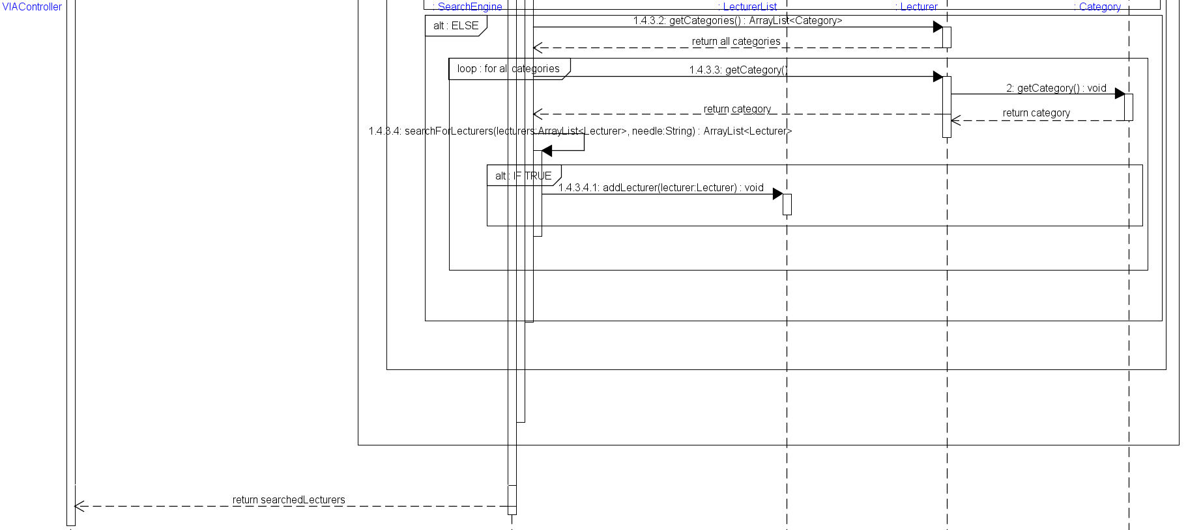
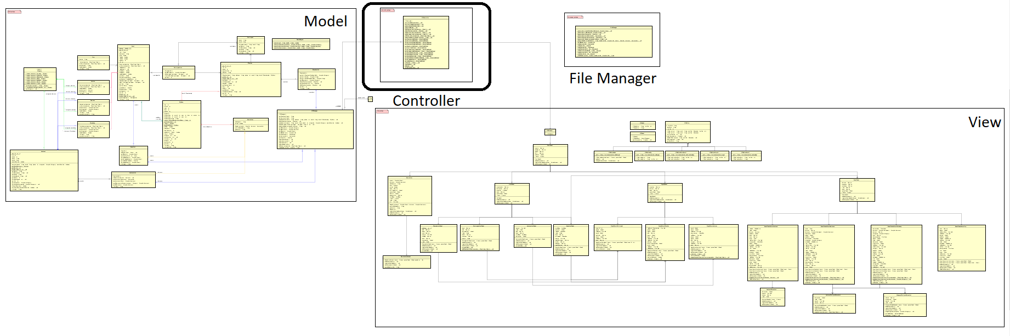
Controller

Slide 22
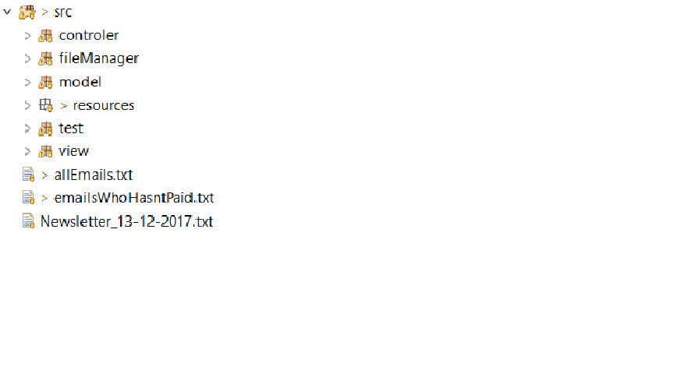

Organizing the code

Slide 23
Implementation

Slide 24
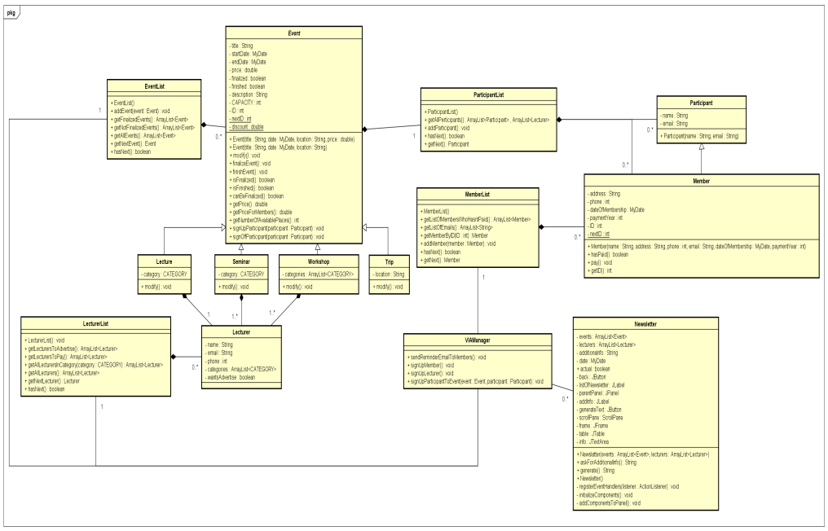
Work Methodology
GUI
MODEL

Slide 25
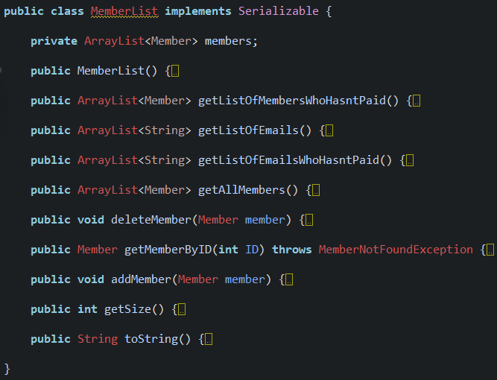
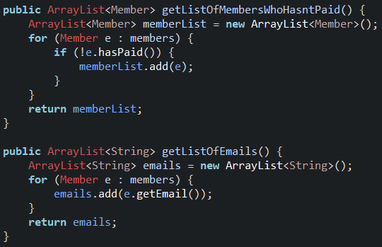
Class example – Member List

Slide 26
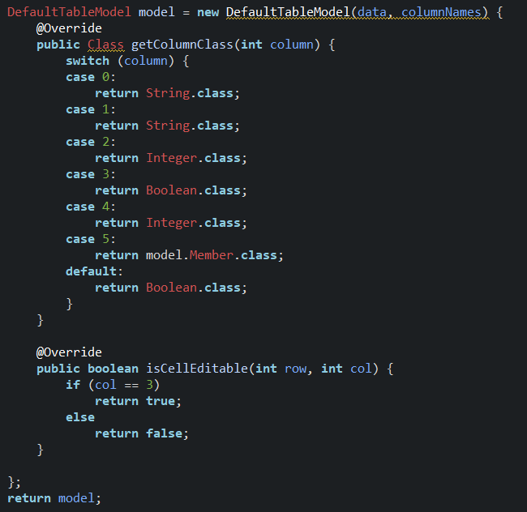
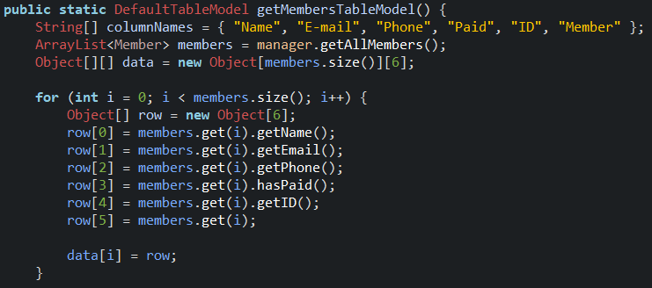
Controller - DefaultTableModel

Slide 27
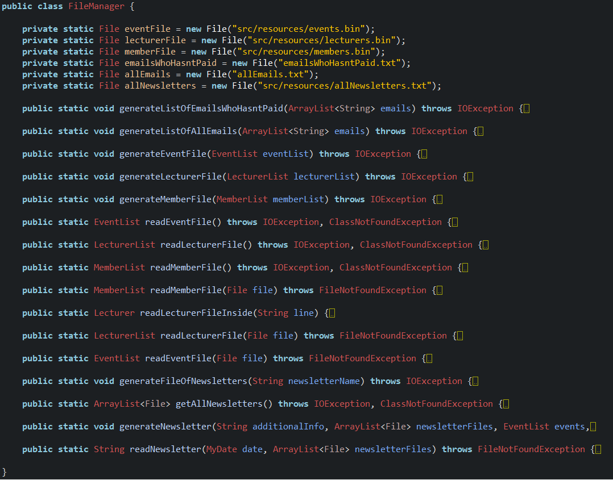
FileManager

Slide 28
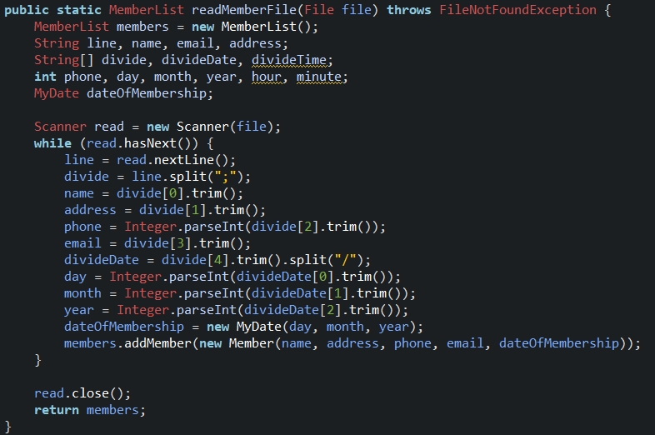
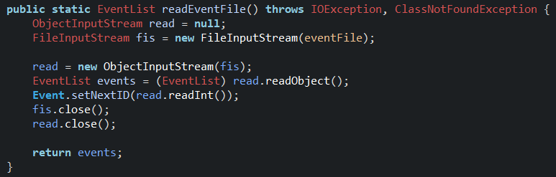
FileManager

Slide 29
Belbin roles, work methods, motivation

Slide 30
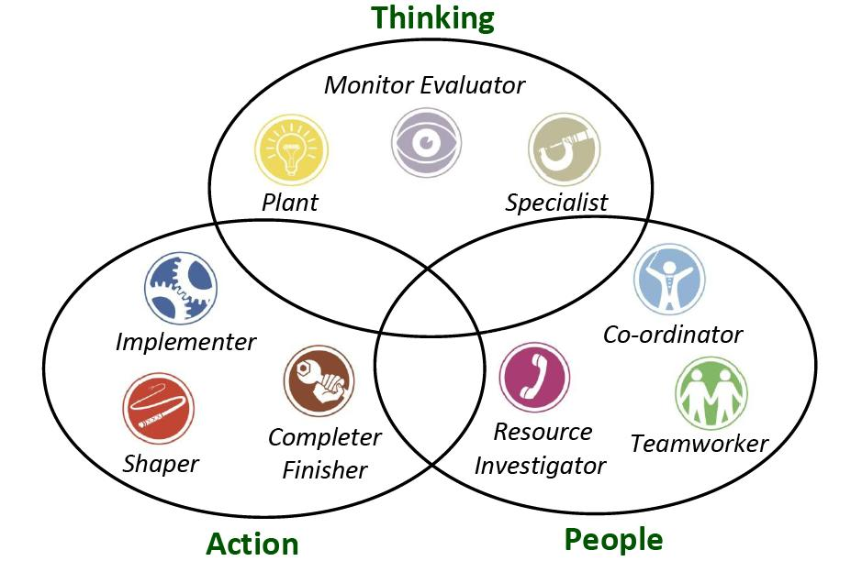

Slide 31
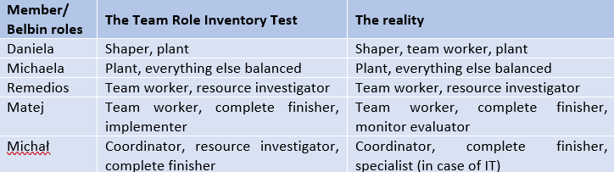
Belbin roles

Slide 32
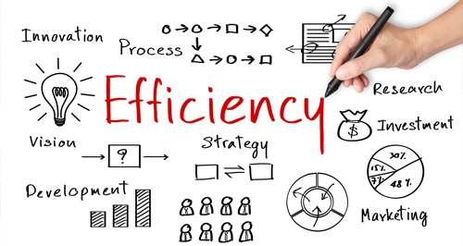
Work Methods
Gather ideas and formulate the main goals
Divide the work between 2/3 persons
Having checked everything by everyone

Slide 33



Using technical tools

Slide 34


Slide 35

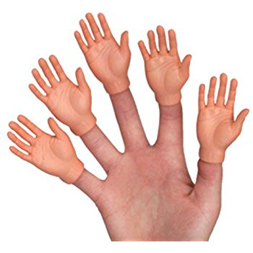
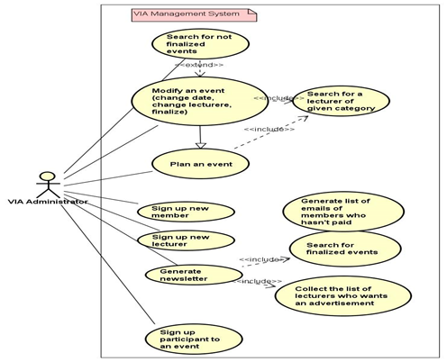
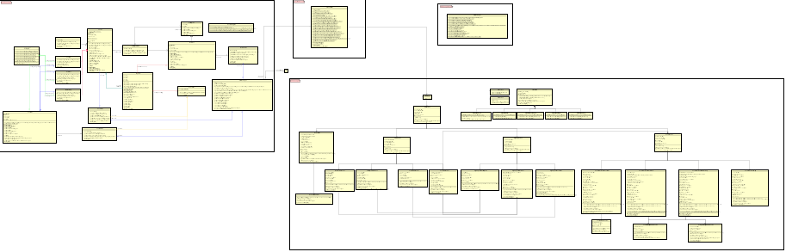


Conclusion (project report)

Slide 36





Conclusion (process report)

Slide 37

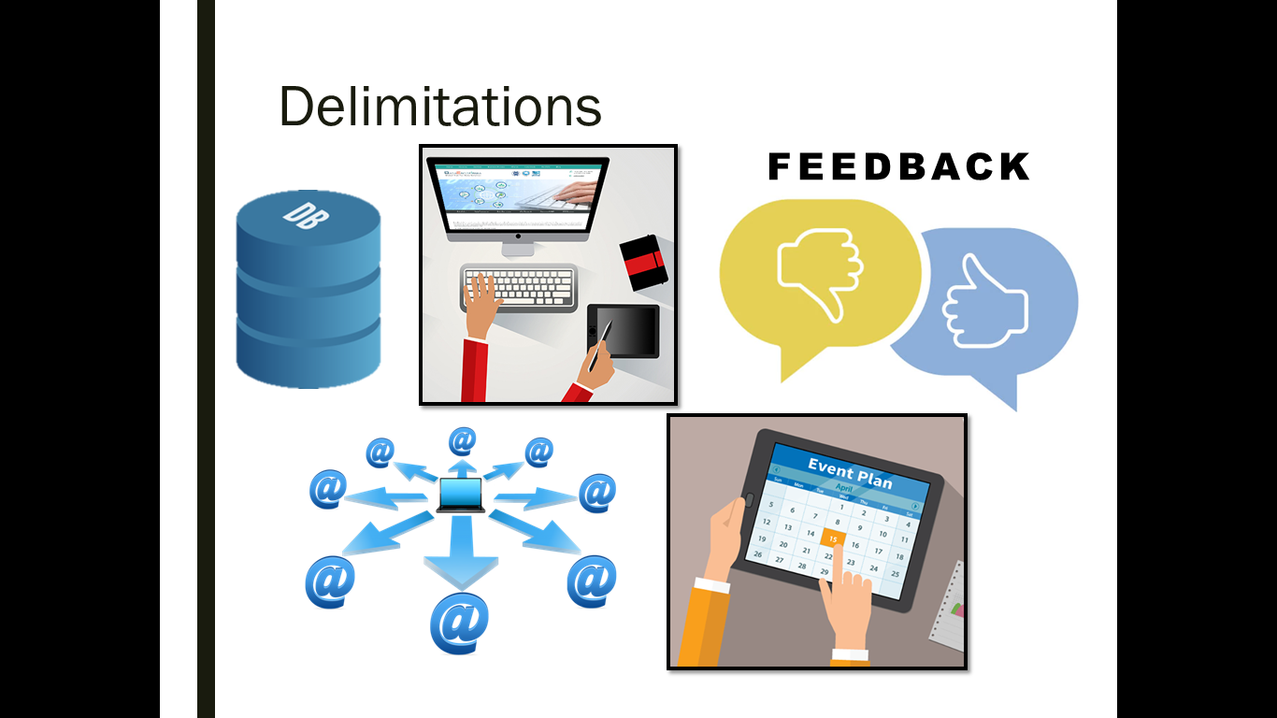
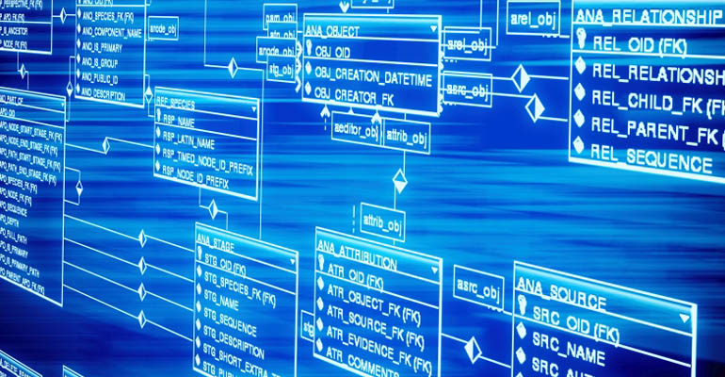


Future

Slide 38

Thank you for your attention.

